Slide 1
Windows 8 General Training Presentation

Slide 2
Revision History
Version: | Date: | Amended By: | Nature Of Change:
0.1 | 11/01/2013 | Harshita Tallam | Initial Draft
0.2 | 11/01/2013 | Harshita Tallam | Added feedback from Stephan Abonyi
0.3 | 23/01/2013 | Harshita Tallam | Used new Template and added feedback from Luc Poirier
0.4 | 26/03/2013 | Harshita Tallam | Added feedback from Surbhi Sharma, Brian Lawless & Ross Bogora
0.5 | 02/04/2013 | Harshita Tallam | Added feedback from Stephan Abonyi
0.6 | 03/04/2013 | Karthik Viswanath | Added feedback from Diane Blackwell for C3 Videos
0.7 | 04/23/2013 | Harshita Tallam | Text Edits, feedback from Diane Blackwell & Ross Bogora
0.8 | 08/05/2013 | Harshita Tallam | Text Edits by Ross Bogora
1.0 | 09/05/2013 | Harshita Tallam | Final Draft

Slide 3

Windows 8: Table of Content
I – BASIC LEVEL
1. Get to know Windows 8
2. The Four Corners
3. Switch between apps
4. Multi Tasking
5. How to access Control Panel
6. How to Pin an Application to the Start Screen
7. Run an application as an Administrator
8. How to Shutdown Windows 8
9. Setting up a basic Wi Fi connection
10. Introduction to Internet Explorer 10
II – INTERMEDIATE LEVEL
11. Searching For Apps and Files in Windows 8
12. Windows 8 Charm menu
13. New File Explorer
14. Enhanced Copy Experience
15. New Keyboard Shortcuts

Slide 4
Windows 8: Table of Content
16. Setting up a Printer
III – ADVANCED LEVEL
17. Windows 8 Task Manager
18. File History (Backup & Restore Tool)
19. Control for PC Settings
20. Reset Your Windows 8 PC
21. Refresh your PC without affecting your files

Slide 5
Introducing Windows 8:
Please note that information contained in these slides is generic and may not fully apply to CSC Enterprise SOEs or other Account-specific SOEs .
“YouTube” links have been provided for general Windows 8 awareness only.
With Windows 8, “The whole experience of Windows has been reimagined”. It is designed to work on a wide range of devices from touch-enabled tablets to laptops, to desktops, and to all-in-ones.
Windows 8 is Microsoft’s next generation of operating system (OS) after Windows 7.
With Windows 8, Microsoft primarily focused on including support and features for touch screen mobile platforms. It is designed to give the user an instant access to apps, files, and information.
Windows 8 runs the same hardware that powers Windows 7.
CSC minimum recommendation for Windows 8 to run on a PC is as follows:
2 GHz (Desktop), 1.66 GHz (Notebook), 1.2 GHz (ULV) processors
2 GB RAM (32-bit) or 4 GB RAM (64-bit)
80 GB hard disk space
Typical disk space utilization (excluding user data): 12-15GB for SOE Tier 0-3, 3GB or more for SOE Tier 4-5.
New PCs typically come configured with 120-160GB of hard disk space.
Intel GM965 Notebook , Intel Q35 Desktop

Slide 6
BASIC LEVEL

Slide 7
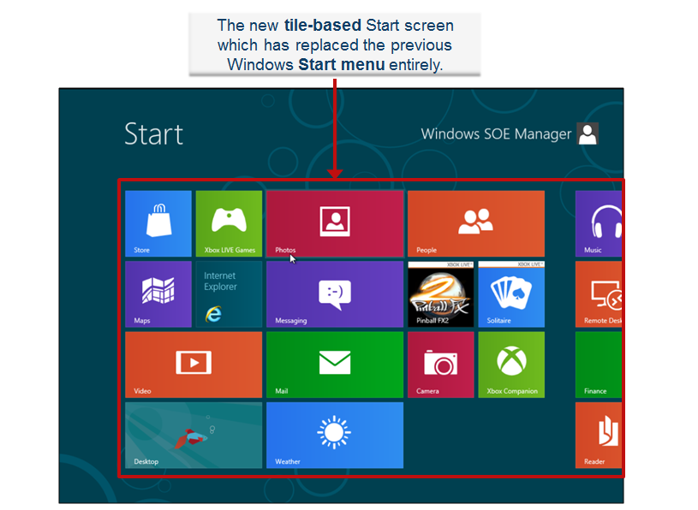
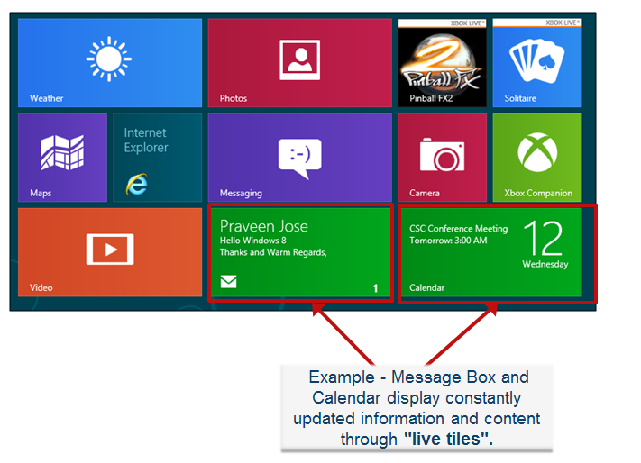
Windows 8 - Get to know Windows 8
Windows 8 employs a new User Interface which features a new tile-based Start screen similar to that of the Windows Phone operating system, which has replaced the previous Start menu entirely. The Start screen displays a customizable array of tiles linking to various apps and desktop programs, some of which can display constantly updated Information and content through "live tiles".
Windows 8 MS Tutorial videos: http://windows.microsoft.com/en-US/windows-8/basics#1TC=t1
Topics: Learn to get around, Use the charms, Go online, The Start screen, All about apps, The familiar desktop, Shutdown

Slide 8
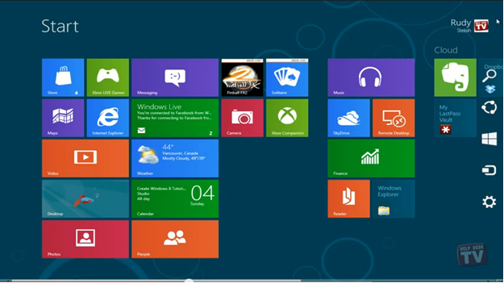
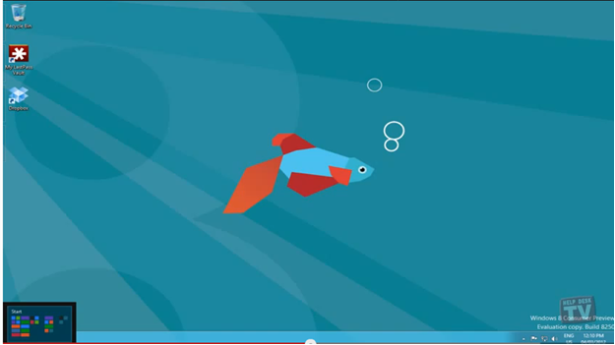
Windows 8: The Four Corners
Top right corner or bottom right corner –
The Charms Menu :
Lower left corner –
The Start Menu

Slide 9
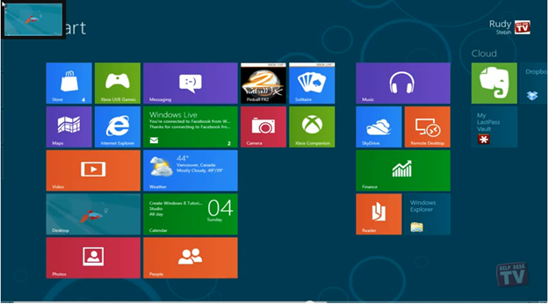
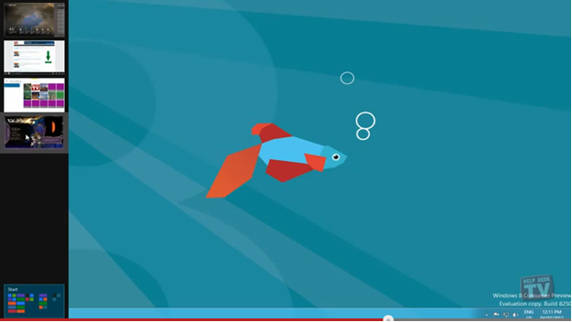
Windows 8: The Four Corners
Upper left corner –
Recent app thumbnail
From upper left corner, drag your
mouse down to see a list of recent apps.
Video Link: http://www.youtube.com/watch?v=hFh2NkQ4-4I&list=PL7874654571CC5864&index=26

Slide 10
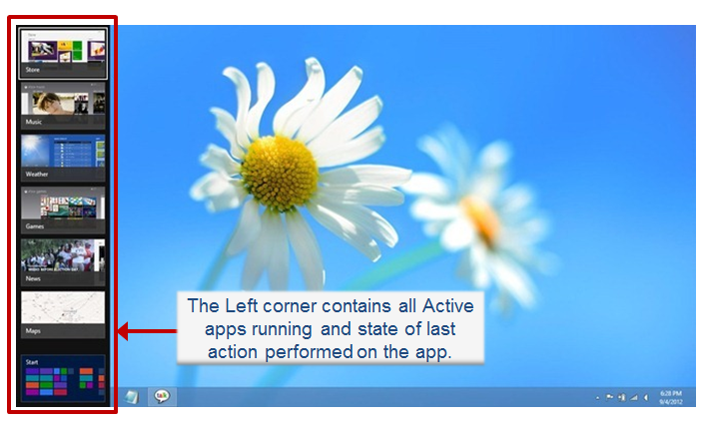
Windows 8 - Switch between apps
Switch List is the alternative to the Alt+Tab feature found in the previous versions of Windows.
You can access it by moving your mouse pointer to the upper or lower left corners of your screen, or simply using the Win+Tab hotkey on your keyboard. This brings up the list of active apps on the left side. It also shows you the current state of the app by displaying the thumbnail of the last action you performed on it.
You can cycle through them by holding down the Windows key and repeatedly pressing the Tab key, or directly open the app via clicking its thumbnail.
Video link: All about apps http://windows.microsoft.com/en-US/windows-8/switch-apps#1TC=t1

Slide 11
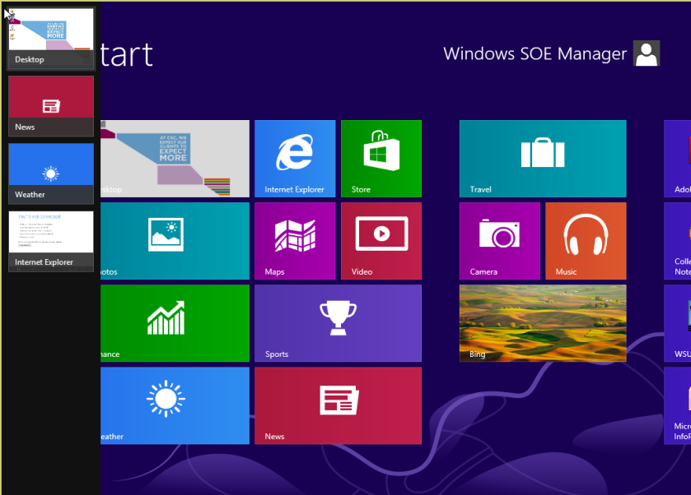
Windows 8 - Multitasking
This function allows you to dock one application into a small strip on the left- or right-hand side of the screen, while continuing to work in another program in the main area of the display.
It allows you more control over selecting the applications you want to use.
Steps for Multitasking function -
When working in full-screen, you'll need to put the cursor in the top left of the screen and then pull down (without pressing any mouse buttons) to reveal thumbnails of all your opened programs. Now left-click and grab the application you want, dragging it away from the other thumbnails. Drop it into the smaller space (if you drop it into the larger space it will simply take up the full screen).
You can repeat the process to choose a program
for the larger space. You can drag the vertical
bar left or right with the mouse to alter the relative
size of your two multi-tasked apps.
Windows 8 MS Tutorial ‘All about apps’ video:
http://windows.microsoft.com/en-US/windows-8/snap-apps#1TC=t1

Slide 12
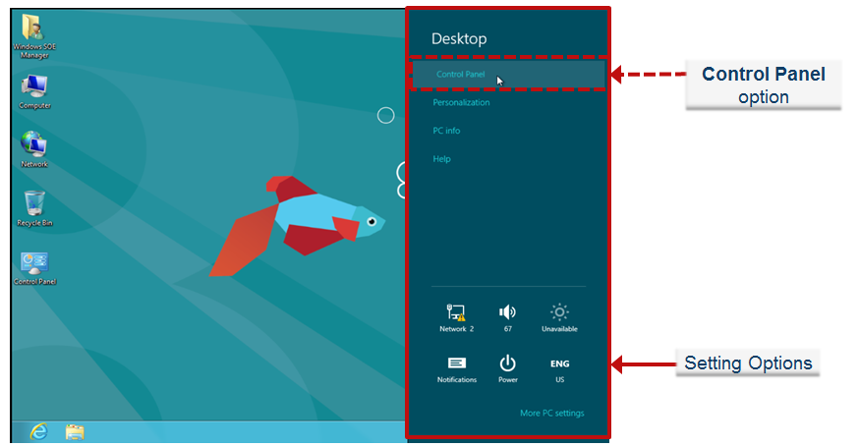
Windows 8 - Control Panel Feature
How to locate the Control Panel in Windows 8:
METHOD 1: Through the Search feature available in the Charms menu on the Start Screen.
The Search pane will pop out. Type Control Panel and select it from the results to the left.
Note: Alternatively, you can simply begin typing from the Start Screen.
METHOD 2: From the Desktop.
On the Desktop, drag the mouse pointer to the Charms Menu and click on Settings.
Settings pane will pop out. Choose Control Panel.
Note: This settings option is only available from the desktop Charms setting.
Video Link: https://c3.csc.com/videos/20422 (Copy-Paste the link into browser)

Slide 13
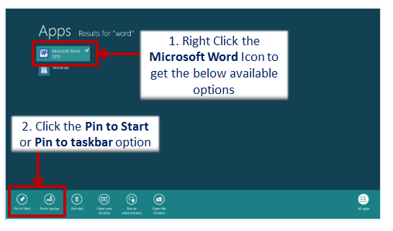
Windows 8 – How to Pin an Application to the Start Screen
Right click the Application icon (Example – MS Word) to get the Pin to Start Screen option.

Slide 14
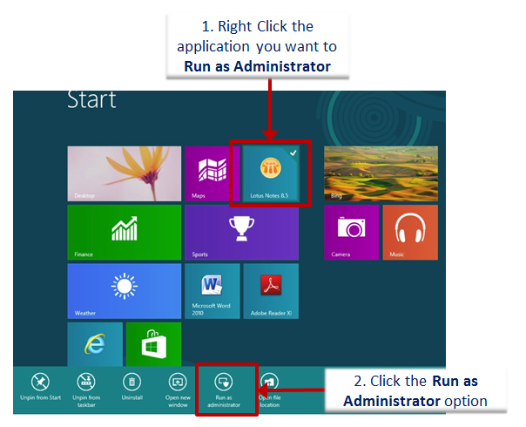
Windows 8 – Run an application as an Administrator
Step 1: Switch to the Windows UI Start screen and start typing the program’s name to see your program under Applications list.
Step 2: Right-click on the program name to see Advanced option.
Step 3: Select the Run as Administrator option.

Slide 15
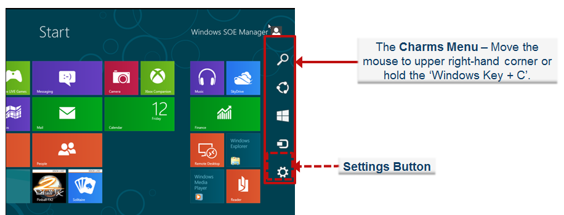
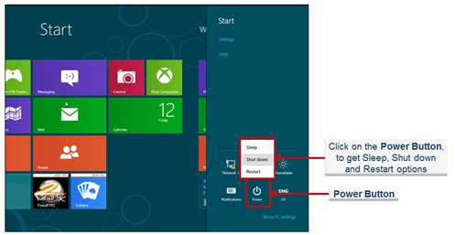
Windows 8 - Shut Down Feature
Method 1: Move your mouse to the upper right-hand corner to trigger the Charms menu (or you can use Windows Key + C ).
To get to the Power Button, from the Charms menu, click the Settings charm, click the Power button and then select Shutdown or Restart.
Note: “Windows Key + I” (capital letter i) will provide the Setting panel with the Power button on it.
Video Link: https://c3.csc.com/videos/20425 (Copy-Paste the link into browser)

Slide 16
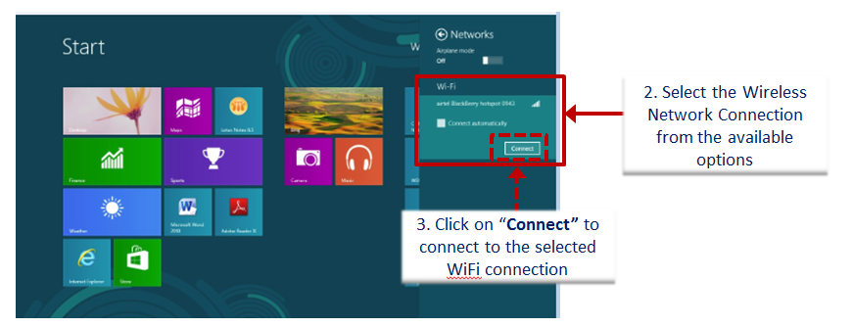
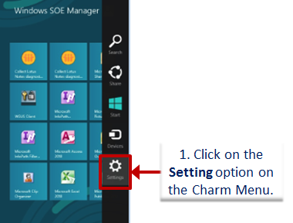
Windows 8 – Setting up a basic Wi Fi connection
You can configure a wireless connection using one of the following options -
From Charm Menu –
Move the mouse cursor to the upper right corner of the screen until the Charms Bar appears. Select Settings and then select Wi Fi. Then select the wireless network connection, and click on Connect.

Slide 17
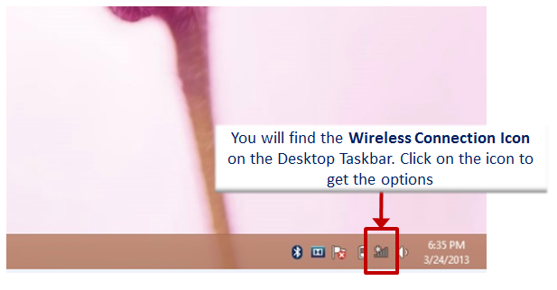
Windows 8 – Setting up a basic Wi Fi connection
From Desktop -
Click on the wireless connection icon from the Desktop Taskbar / System Tray. Then Select the wireless connection from the list that will open on the right side of the screen. The wireless connection configuration will start and you can add the network security key.

Slide 18
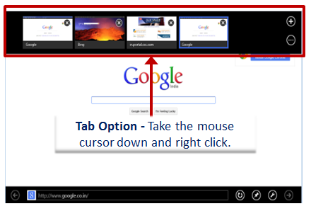
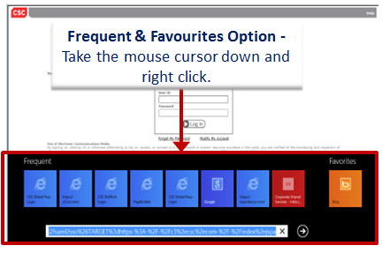
Windows 8 – Introduction to Internet Explorer 10
Internet Explorer 10 provides one web platform that supports two browsing experiences: Internet Explorer in the new Windows UI that is optimized for touch devices, and the familiar browsing experience of Internet Explorer for the desktop.
IE access from Start Screen –
Internet access is provided from the START PAGE, it does not allow for multiple searches windows and restricts access to some sites.

Slide 19
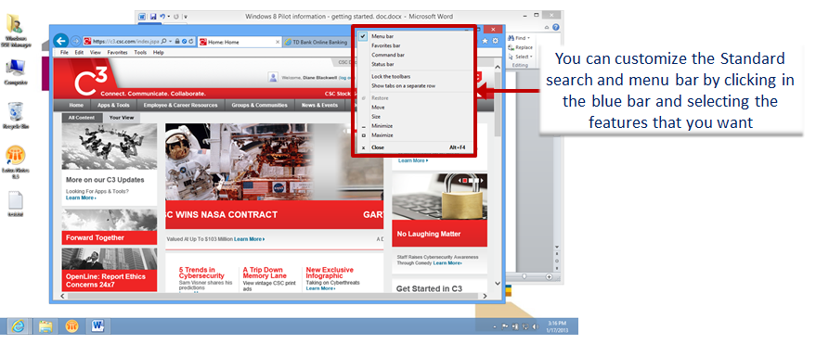
Windows 8 – Introduction to Internet Explorer 10
IE access from Desktop –
Intranet access is provided from the DESKTOP, this is the IE access that should be used for all CSC business. The desktop IE is secure and should be used for all corporate business use, it includes the standard search and menu bar.
Video Link: http://www.youtube.com/watch?v=9LkF2meNwBA

Slide 20
INTERMEDIATE LEVEL

Slide 21
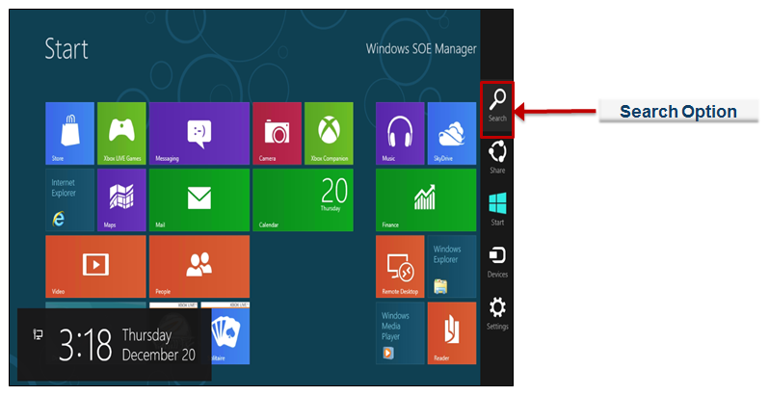
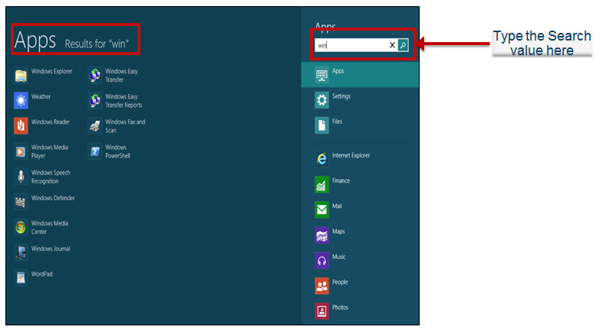
Windows 8: Searching For Apps and Files in Windows 8
Any Files, Installed Applications and Control Panel settings can be searched using the Search Option.
The Search pane will pop out. Type the word
you want to search and select it from the
results to the left.
Note: Alternatively, you can simply begin
typing from the Start Screen.
Video Link: http://www.youtube.com/watch?v=CiPBlZP4nuo&list=PL7874654571CC5864&index=1

Slide 22
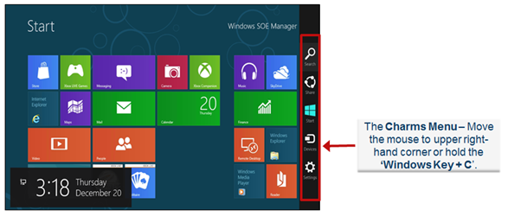

Windows 8 – Charm Menu
Windows 8 universal toolbar - Charm Menu can be accessed from anywhere regardless of which application we are working on.
How to locate the Charm menu in Windows 8:
Method 1: By dragging your mouse pointer to the top or bottom right corner of the screen
Method 2: Hold ‘Windows Key + C’
Five Key Elements of Charm Menu – Search, Share, Start, Devices and Settings
Video Link: https://c3.csc.com/videos/19488 (Copy-Paste the link into browser)

Slide 23
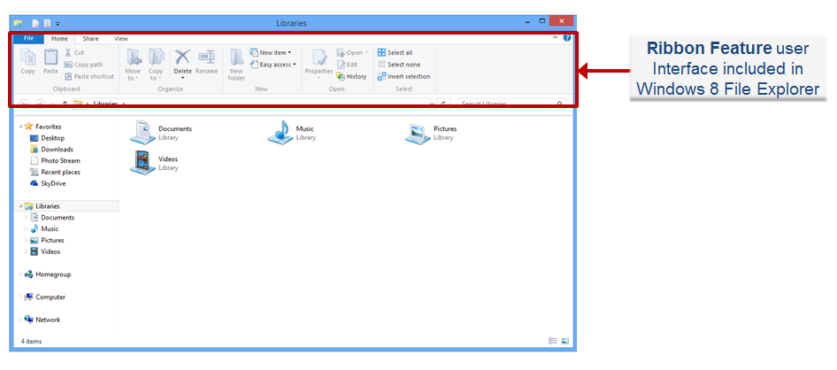
Windows 8 - New file Explorer
Windows 8 includes an updated version of Windows Explorer that has been redesigned as File Explorer. In it the file management tool has given a slightly new user interface that features Ribbon toolbar instead of a traditional drop down menu system.
Video Link: http://www.youtube.com/watch?v=5BzGDpzs_fw

Slide 24
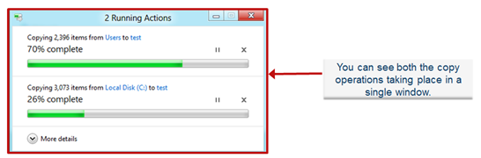
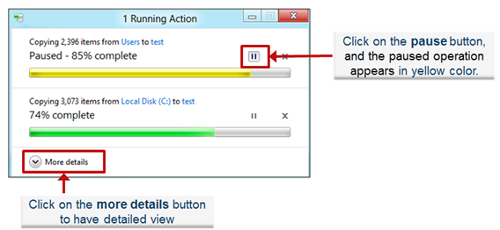
Windows 8 - Enhanced Copy Experience
Microsoft has enhanced the copy experience in Windows 8 for faster and easier use.
Windows 8 has consolidated the copy experience, where you can review all the copy jobs in Single Dialog Box. It presents all the pending copy jobs in a single window without need to navigate between different dialogue boxes.
Windows 8 also has ability to pause, resume
and stop all the current copy jobs in a single
dialog box. You can give precedence to your
multiple copy operations.
Video Link: https://c3.csc.com/videos/19487
(Copy-Paste the link into browser)

Slide 25
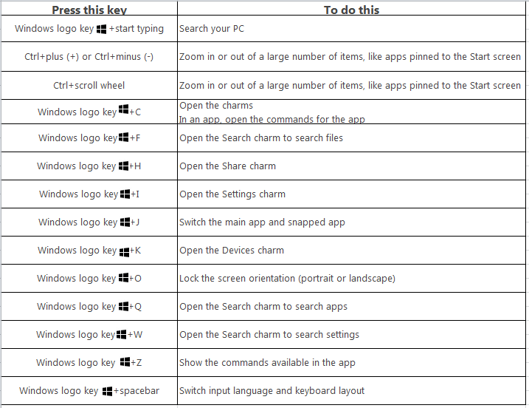
Windows 8 – New Keyboard Shortcuts

Slide 26
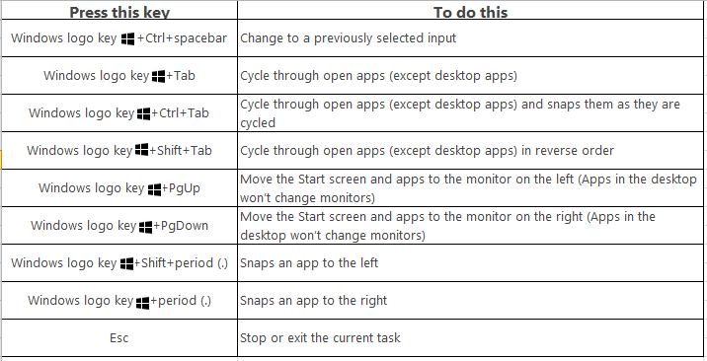
Windows 8 - New Keyboard Shortcuts

Slide 27
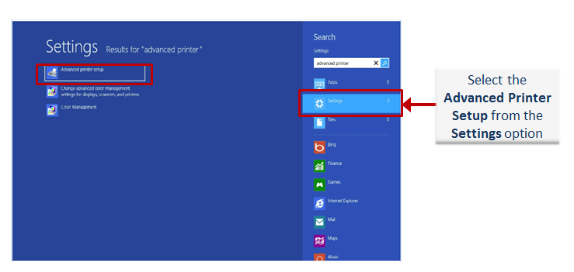
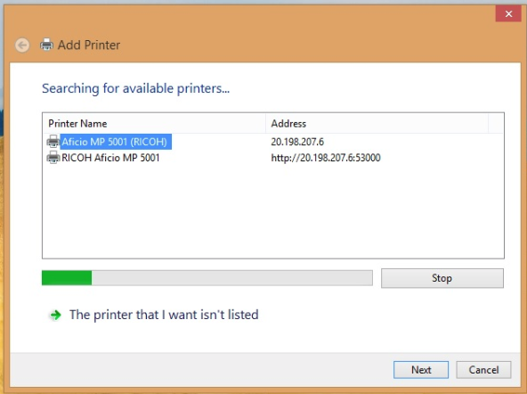
Windows 8 – Setting up a Printer
METHOD 1 –
1. Enter Advanced printer setup in the search box, tap or click Settings, and then tap or click Advanced printer setup.
2. Follow the steps for additional printer installation options.

Slide 28
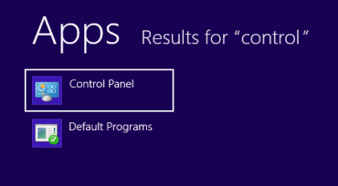
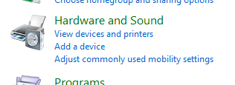

Windows 8 – Setting up a Printer
METHOD 2 –
1. On the Start Screen, type ‘Control Panel’, click on the Control Panel tile that will be displayed and then select ‘Hardware and Sound’, ‘View devices and printers’ and ‘Add a printer’ . A search window will be opened and printers that are available will be listed.
2. This step assumes that the system is connected to network. From the printers that are displayed, select one printer and hit ‘Next’. Follow the driver installation and set-up instructions for the printer.

Slide 29
ADVANCED LEVEL

Slide 30
Windows 8 - Task Manager
How to access Task Manager in Windows 8:
METHOD 1: Right click on the taskbar on the desktop, and select Task Manager.
METHOD 2: From the Lock Screen menu.
Hold the CTRL+ALT+DELETE keys, then click on Task Manager.
METHOD 3: Open the Control Panel (icons view), and click on the Performance
Information and Tools icon.
Step 1: In the left pane, click on the Advanced Tools link.
Step 2: Click on the Open Task Manager

Slide 31
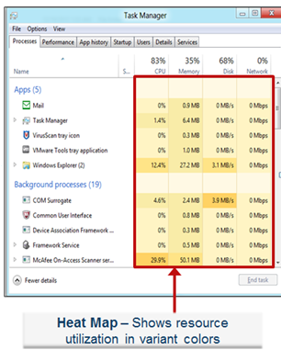
Windows 8 - Task Manager
Heat Map Feature
Heat Map is the most noticeable difference in the new Processes tab.
It represents different values with color.
Heat map allows you to monitor anomalies across
multiple resources (network, disk, memory, and
CPU utilization) all at the same time, without having
to sort the data. It also allows you to find the hot spot
instantly without needing to read numbers or
understand concepts or specific units.
Video Link: https://c3.csc.com/videos/19477

Slide 32
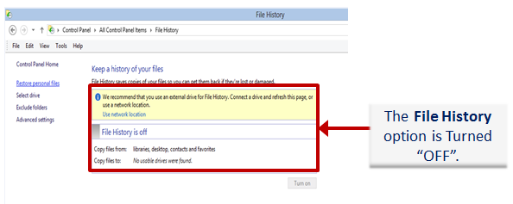
Windows 8 - File History (Backup & Restore Tool)
File History doesn't back up your whole system. Instead, it only backs up the files in your Libraries—essentially, your personal documents, files, and media. You can add any folders you want to a library, of course, but it won't back up your entire computer the way Windows 7 File Recovery does.
Also, instead of running large backups every week or month, it takes a snapshot of your files every hour, so you can restore your files in a much more fine-grained fashion.
To turn the File History option "ON", it requires an external drive or Network location.

Slide 33
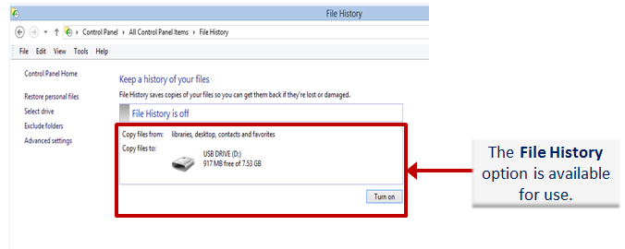
Windows 8 - File History (Backup & Restore Tool)
Once you connect an external drive or to a network location, the File History option gets enabled for use.
Video Link: http://www.youtube.com/watch?v=U1zkQBCxdBs

Slide 34
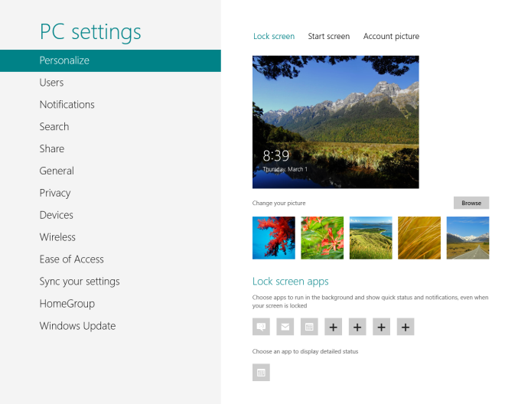
Windows 8 – Control for PC Setting
PC users have long been using Control Panel as the hub for controlling their system settings.
With the introduction of Metro UI in Windows 8, while the Control Panel is still there for desktop mode, there has been a new hub introduced in Windows 8 called PC settings, that lets you change several important settings of your PC from a beautiful, streamlined, no-frills interface.
PC Settings can be accessed as follows:
1. Open Charms bar by holding Windows key + C
2. On the Charms bar, select ‘Settings’.
3. Now select ‘Change PC settings’ link that shows
up at the end.
Video Link: http://www.youtube.com/watch?v=71YrkD4Mkpo

Slide 35
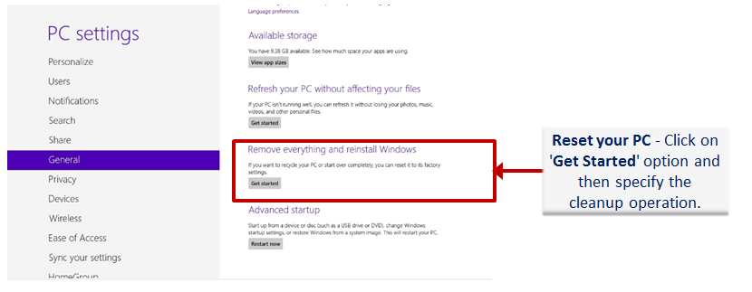
Windows 8 - Reset Your Windows 8 PC is not supported
“Reset your PC” and “Refresh your PC” are not supported in the SOE.
If your system needs a reset or refresh to address issues, a reinstall of the Windows 8 SOE will be required.
Video Link: http://www.youtube.com/watch?v=aVQ6yge7qzE

Slide 36
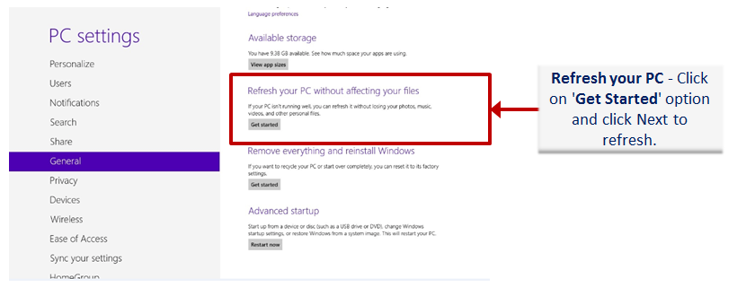
Windows 8 - Refresh your PC is not supported
“Reset your PC” and “Refresh your PC” are not supported in the SOE.
If your system needs a reset or refresh to address issues, a reinstall of the Windows 8 SOE will be required.

Slide 37
VIDEO LINKS

Slide 38
Windows 8: Video Links
Note: Copy-Paste the C3 links into browser to view the video content
CONTENT | VIDEO LINKS
Get to know Windows 8 | http://windows.microsoft.com/en-US/windows-8/basics#1TC=t1
How to Shutdown Windows 8 | https://c3.csc.com/videos/20425
The Four Corners | http://www.youtube.com/watch?v=hFh2NkQ4-4I&list=PL7874654571CC5864&index=26
Searching For Apps and Files in Windows 8 | http://www.youtube.com/watch?v=CiPBlZP4nuo&list=PL7874654571CC5864&index=1
How to access Control Panel | https://c3.csc.com/videos/20422
Windows 8 Task manager | https://c3.csc.com/videos/19477
Windows 8 Charm menu | https://c3.csc.com/videos/19488
Enhanced Copy Experience | https://c3.csc.com/videos/19487
New File Explorer | http://www.youtube.com/watch?v=5BzGDpzs_fw
Control for PC Settings | http://www.youtube.com/watch?v=71YrkD4Mkpo
File History (Backup & Restore Tool) | http://www.youtube.com/watch?v=U1zkQBCxdBs

Slide 39
Windows 8: Video Links
CONTENT | VIDEO LINKS
Refresh and Reset Your Windows 8 PC | Not Supported
Switch between apps | http://windows.microsoft.com/en-US/windows-8/switch-apps#1TC=t1
Multi Tasking | http://windows.microsoft.com/en-US/windows-8/snap-apps#1TC=t1
Introduction to Internet Explorer 10 | http://www.youtube.com/watch?v=9LkF2meNwBA
Notes:
Video links to Youtube should be replaced with a MS or CSC version

Slide 40
THANK YOU

